Slide 1
Probabilistic RoadMap
Motion Planning Algorithm and Path Planning Method
Reference:
Lydia E. Kavraki, Petr Svestka, Jean-Claude Latombe, and Mark H .Overmars: “Probablilistic Roadmaps for Path Planning in High-Dimentional Configuration Spaces” IEEE TRANSACTIONS ON ROBOTICS AND AUTOMATION, VOL, 12, NO. 4, AUGUST 1996

Slide 2
Overview
Probabilistic Roadmap (PRM) is a path planning algorithm used in robotics and computer graphics to find feasible paths in complex environments. Works by randomly sampling (node) in free space, which are then connected to nearest neighboars to form a graph or roadmap (K-Nearest). Graph between nodes represents possible paths a robot can take while avoiding obsticles.

Slide 3
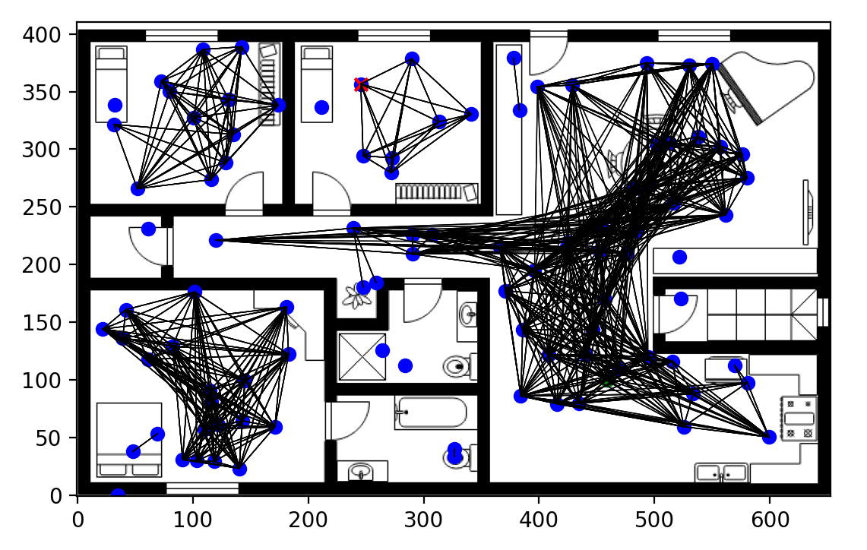
Node’s Connections
In the context of Probabilistic Roadmap, node connection is a crucial step where randomly sampled nodes in the free space are linked to form a roadmap

Slide 4
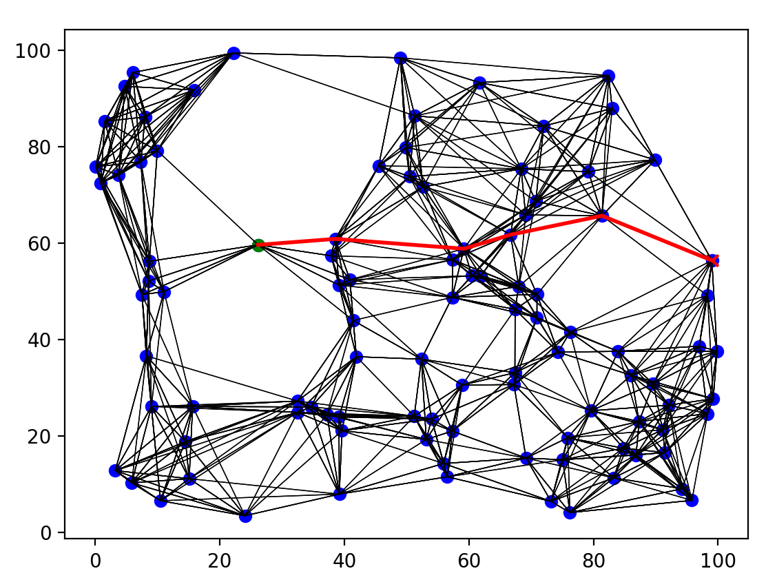
Bresenham’s Line Algorithm
Bresenham’s Line Algorithm calculates the points of an node-dimensional raster that should selected to form a close approximation to a line between nodes

Slide 5
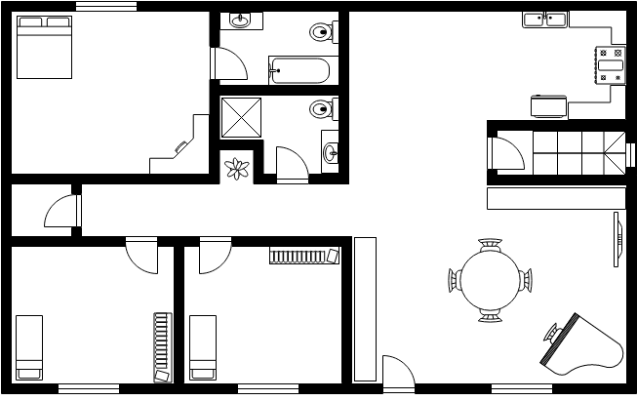
Interflating obstacles mapping
The process of inflating obstacles in a binary obstacle to declare paths generated by PRM avoid getting to close to obsticles by expanding the boundaries of each obstacle by a certain number of pixels

Slide 6
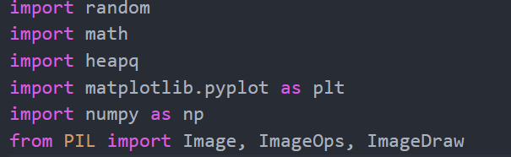
Code Explanation
Using PyPi such as:
Random: Python’s build-in library for generating random numbers and sequences.
Math: Python’s build in library providing mathematical functions and constants.
Heapq: Python’s build in library for heap queue algorithm implementations, used here for priority queue fungtionalities.
Mathplotlib: A plotting library for creating static, animated and interactive visualizations in python.
Numpy: Numerical computing in python.
PIL (Python Imaging Library): Opening, manipulating, and saving many different image file

Slide 7
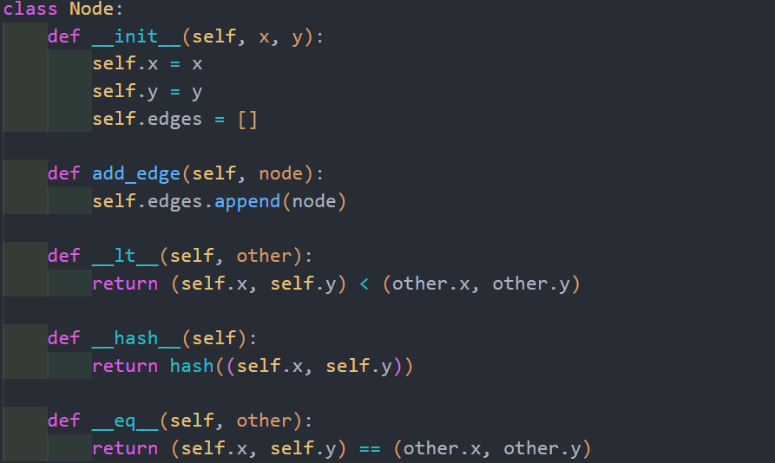
• __init__(self, x, y): Constructor method initializes a Node object with its x and y coordinates in a 2D space. The edges variable is used to store a list of other nodes that are directly connected to this node.
• add_edge(self, node): Method adds another node (node) to the edges list, representing an edge connecting this node to another node in the graph.
• __lt__(self, other): Special method (<) defines the less-than comparison rule between two nodes based on their (x, y) coordinates. This is used for sorting or comparison operations involving nodes.
• __hash__(self): Special method returns the hash value of the node object. It's necessary to support using nodes as keys in hash-based data structures like dictionaries or sets
.
• __eq__(self, other): Special method (==) defines the equality comparison rule between two nodes based on their (x, y) coordinates. It checks if two nodes are identical.

Slide 8
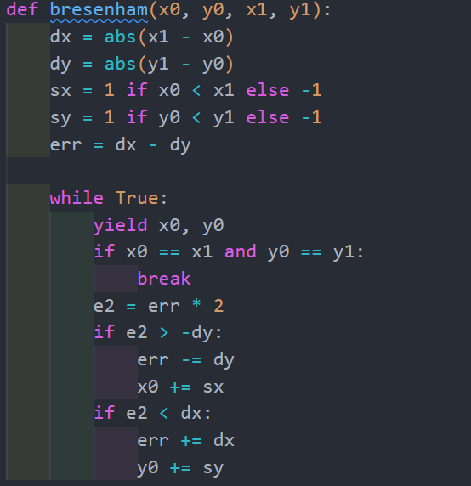
• dx: The difference between the x-coordinates of the two points (x1 - x0).
• dy: The difference between the y-coordinates of the two points (y1 - y0).
• sx: The direction of the x-axis step (1 if x0 < x1, -1 otherwise).
• sy: The direction of the y-axis step (1 if y0 < y1, -1 otherwise).
• err: Error variable to track pixel position estimation.
• Through the while True loop, the algorithm continuously yields points that form the line from (x0, y0) to (x1, y1) until the endpoint is reached.
• Each iteration, the current point (x0, y0) is yielded as output.
• The algorithm uses error calculation (err) to determine the next step either along the x-axis or y-axis based on the differences dx and dy.
• In each step, the value of err is updated based on conditions involving e2 > -dy or e2 < dx.
• When x0 and y0 reach x1 and y1 respectively, the iteration stops using break.

Slide 9
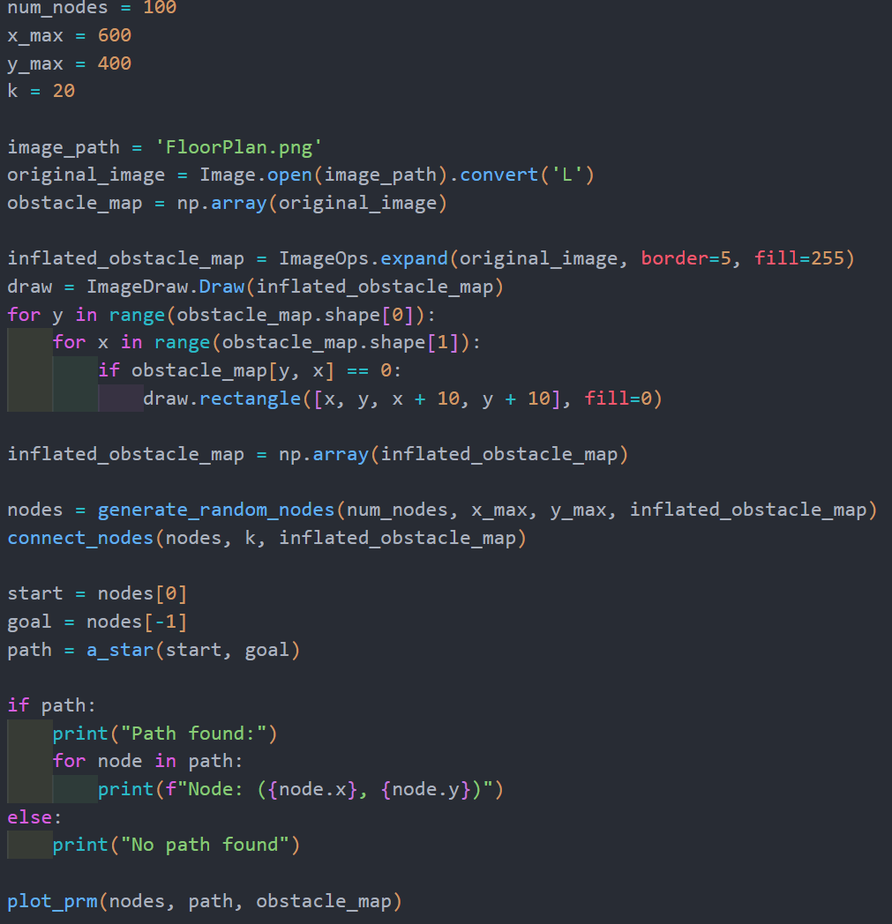
• image_path = 'Obsticle.png': Specifies the path to the obstacle map image file.
• original_image = Image.open(image_path).convert('L'): Opens the image and converts it to grayscale ('L' mode).
• obstacle_map = np.array(original_image): Converts the image into a NumPy array for easier manipulation.
• inflated_obstacle_map = ImageOps.expand(original_image, border=5, fill=255): Creates an inflated version of the obstacle map by adding a border of 5 pixels around each obstacle (where pixel value is 0). Pixels outside obstacles are filled with 255 (white).
• draw = ImageDraw.Draw(inflated_obstacle_map): Prepares to draw on the inflated obstacle map.
• A loop iterates through the original obstacle map pixels (obstacle_map). When encountering a pixel value of 0 (indicating an obstacle):
• draw.rectangle([x, y, x + 10, y + 10], fill=0): Draws a filled rectangle of size 10x10 at position (x, y) on the inflated obstacle map, marking the obstacle area.
• nodes = generate_random_nodes(num_nodes, x_max, y_max, inflated_obstacle_map): Generates 100 random nodes (num_nodes) within the specified dimensions (x_max and y_max) while ensuring they do not overlap with obstacles marked in inflated_obstacle_map.
• connect_nodes(nodes, k, inflated_obstacle_map): Connects each node to its 5 nearest neighbors (k) if a straight-line path between them does not intersect with obstacles.•
• If a path is found (if path:), it prints each node's coordinates along the path.• plot_prm(nodes, path, obstacle_map): Visualizes the PRM, displaying nodes, edges, obstacles, and the path (if found) overlaid on the original obstacle map using matplotlib.

Slide 10
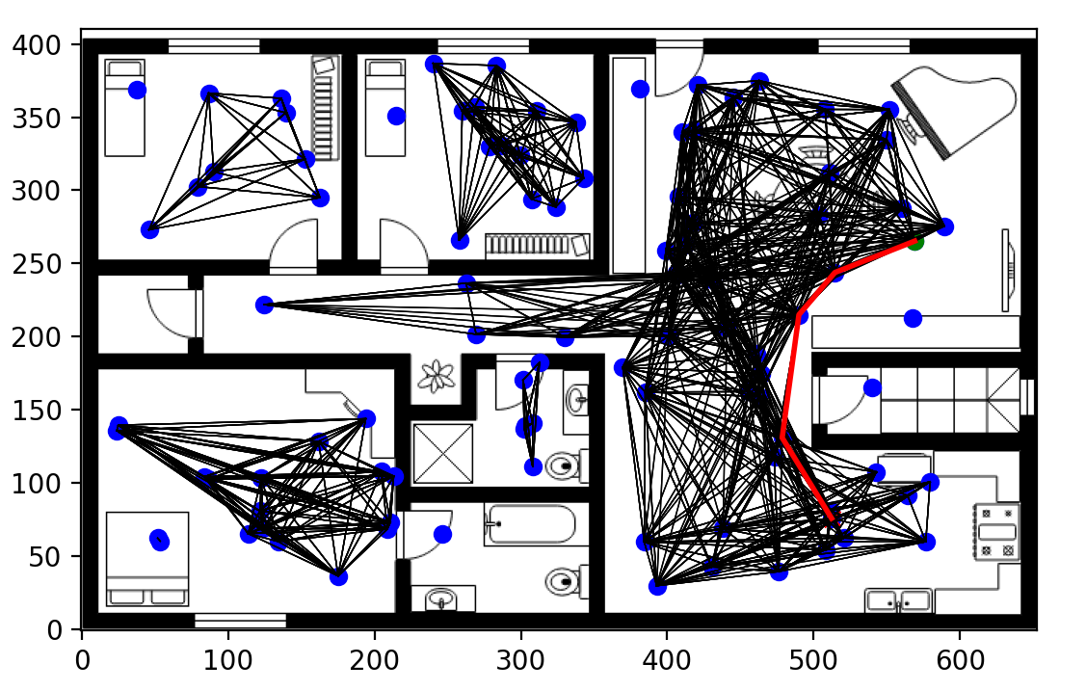
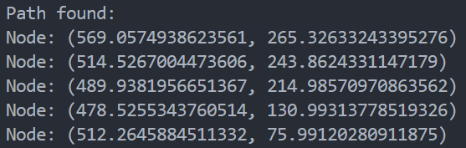
Output Representation
Original .PNG
Probabilistic Roadmap Path Planning

